Slide 1

Green Pace
Security Policy Presentation
Developer: Jacob Mueller

Slide 2

OVERVIEW: DEFENSE IN DEPTH
The security policy covers a host of subtle and obvious vulnerabilities ranging in their severity. Some of the standards herein will seem like common sense.

Slide 3
10 PRINCIPLES
Validate Input Data
Heed Compiler Warnings
Architect and Design for Security Policies
Keep it Simple
Default Deny
Adhere to the Principle of Least Privilege
Sanitize Data Sent to Other Systems
Practice Defense in Depth
Use Effective Quality Assurance Techniques
Adopt a Secure Coding Standard

Slide 4
CODING STANDARDS
Do not cast to an out-of-range enumeration value. – Data Type
Value-returning functions must return a value from all exit paths. – Data Value
Guarantee that storage for strings has sufficient space for character data and the null terminator. – String Correctness
Prevent SQL Injection – SQL Injection
Do not access freed memory – Memory Protection
Use a static assertion to test the value of the constant expression – Assertions
Exception objects must be no-throw copy constructable. – Exceptions
Do not alternately input and output from a file stream without an intervening positioning call – Input/Output
Guarantee that container indices and iterators are within the valid range – Containers
Copy operations must not mutate the source object – Object Oriented Programming

Slide 5
THREATS MATRIX
Broken down into likely to happen, high priority, low priority, and unlikely quadrants.
S2, S8, S9, S10 are somewhere in the middle while S3, S4, and S5 are likely threats and take a high priority.
Likely | Priority
Low priority | Unlikely
S5
S3
S4
S7
S9
S2
S6
S10
S8
S1

Slide 6
ENCRYPTION POLICIES
Encryption at rest is a means of protection for stored data designed to prevent attackers from accessing any unencrypted data by ensuring that it is instead encrypted. It’s used primarily to prevent attacks where a hacker would obtain access to the storage or database, but wouldn’t have the means to bypass encryption. High priority and highly recommended.
Encryption at flight is when data is encrypted when it’s being transmitted, and should be applied by using secure transfer such as SFTP (Secure File Transfer Protocol). Data is vulnerable during flight if left unencrypted or improperly secured. VPN may offer the level of defense desired in the current climate.
Encryption in use is when data is accessed or used by an application or by an end user. This is widely considered the most vulnerable and needs to be limited to users who need it, look to the rule of least power.

Slide 7
TRIPLE-A POLICIES
Authentication - The process when the user wants to access the network and needs credentials such as a username and password.
Authorization -Enforces policies on networks for the user and gives them access to only the resources that they need.
Accounting -Holds users accountable for their actions and keeps track of who does what by monitoring or logging an user’s activities.

Slide 8
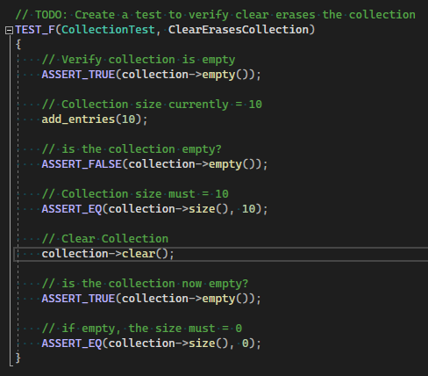
Unit Testing

Slide 9
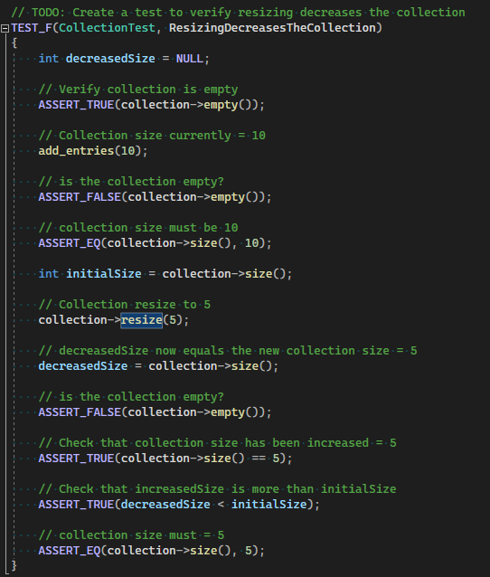
Unit Testing

Slide 10
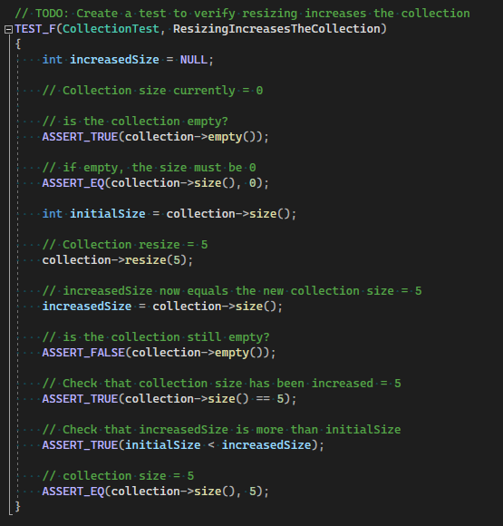
Unit Testing

Slide 11
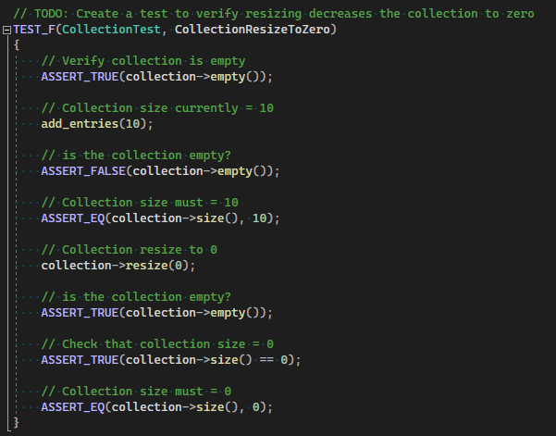
Unit Testing

Slide 12

AUTOMATION

Slide 13
Automation Summary
Automation will be used for the enforcement of and compliance to the standards defined in this policy. Green Pace already has a well-established DevOps process and infrastructure. Define guidance on where and how to modify the existing DevOps process to automate enforcement of the standards in this policy. Use the DevSecOps diagram and provide an explanation using that diagram as context.
Automation is a necessity in the development of software and can be utilized in many areas and at almost anytime during the development cycle. That being said, it should be used within reasonable timelines, meaning it may be used from the start but might not have the most impact on the development, also it may take up too much time if over utilized. When implemented properly, automation can do a lot of heavy lifting parsing code for vulnerabilities, testing functionality, and configuring security measures.

Slide 14
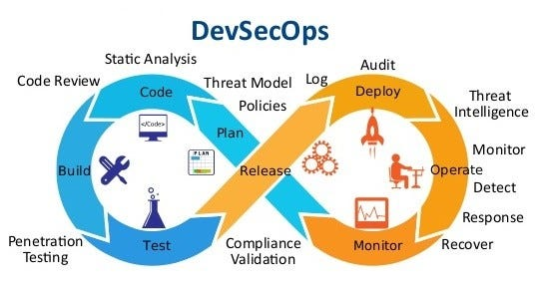
TOOLS
The devsecops pipeline is the course the project takes as it cycles through release and planning stages
Automation helped in the code, build, and test portions of the devsecops pipeline. CPP check was used to assess coding efficiency, visual studio handles the building and can even help with testing if the right frameworks are in use.
Depending on how the project is deployed there are automated monitoring options that will help shore up the defenses after release.

Slide 15
RISKS AND BENEFITS
Hackers already have a head start, they are able to build off of the same concepts and basic logic that we referenced for this policy
Starting early and communicating often will lead to a more comprehensive defense
Waiting to develop defensive measures once we decide on the data structures and functionality of our project could mean missing out on vulnerabilities that take time to catch or patch.

Slide 16
RECOMMENDATIONS
Incorporate more languages within our assessments and policies
Or pare down the amount of languages in use to provide deeper security for a smaller coding language pool

Slide 17
CONCLUSIONS
With the bulwark provided there is nowhere to go but forward into a zero trust security policy that will build upon our principles and standards.

Slide 18
REFERENCES
Blogumas, T. (2020, April 21). Top 15 devsecops tools for an enterprise CI/CD pipeline. Medium. https://levelup.gitconnected.com/top-15-devsecops-tools-for-an-enterprise-ci-cd-pipeline-bd865b47ed5f

